Slide 1


Introducing women and girls to technology, entrepreneurship and innovation.

Slide 2
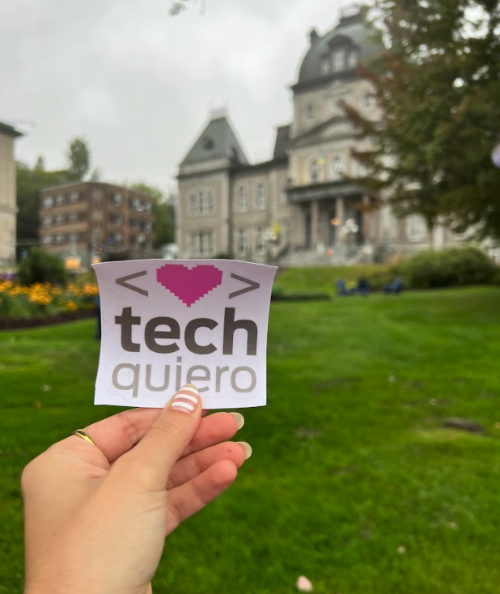

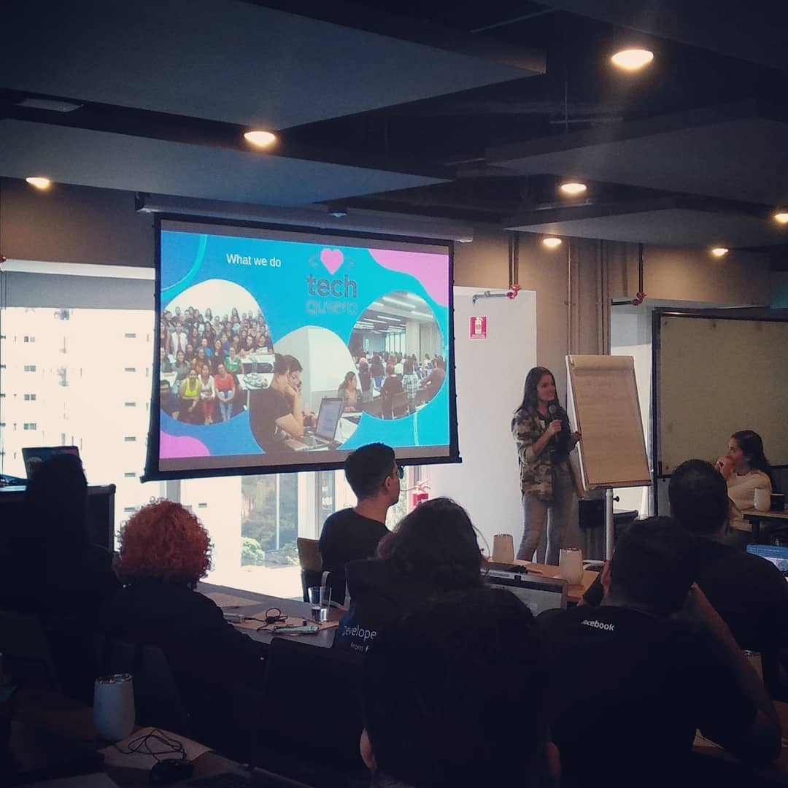
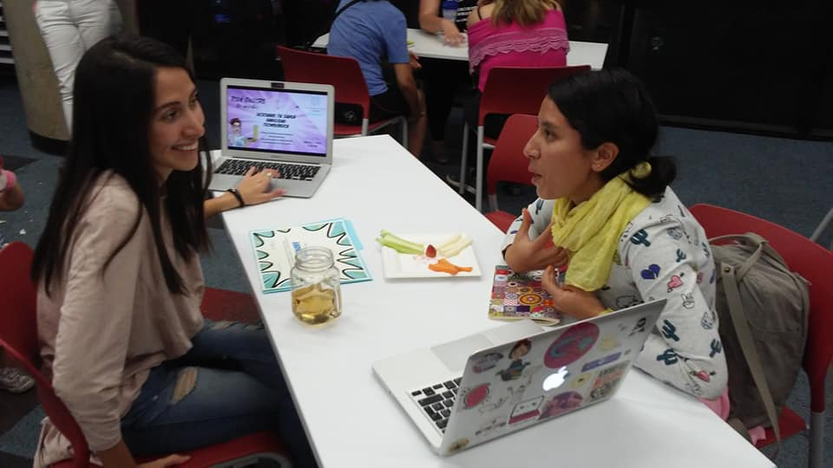
Tech Quiero is a non-profit organization based in Sherbrooke, QC, led by women, which aims to create spaces for women and minorities to learn, adopt new skills and get into the tech industry.
We develop skills from scratch and fill in the
opportunities gaps in the tech sector, while closing the gender gap in the STEM industry.

Slide 3
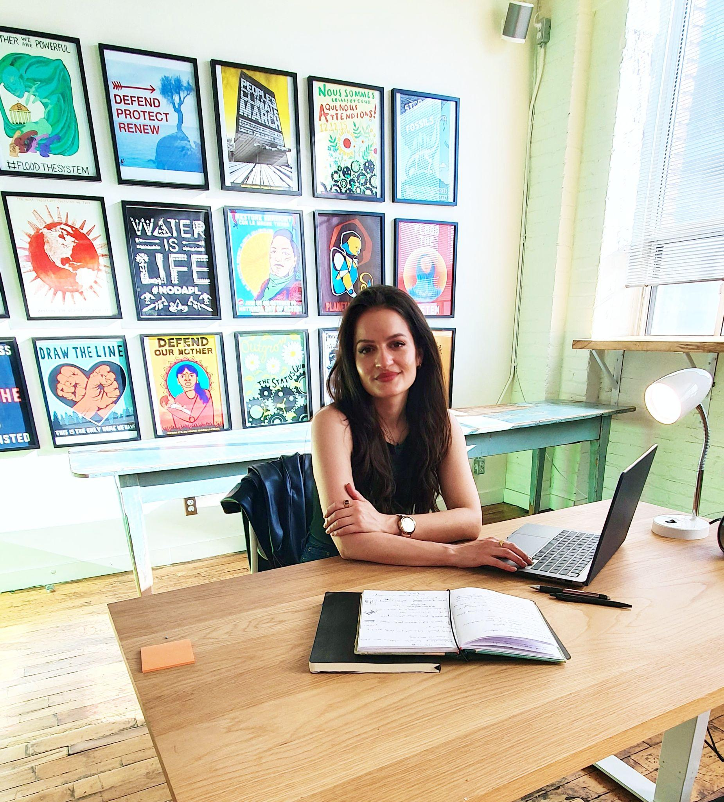
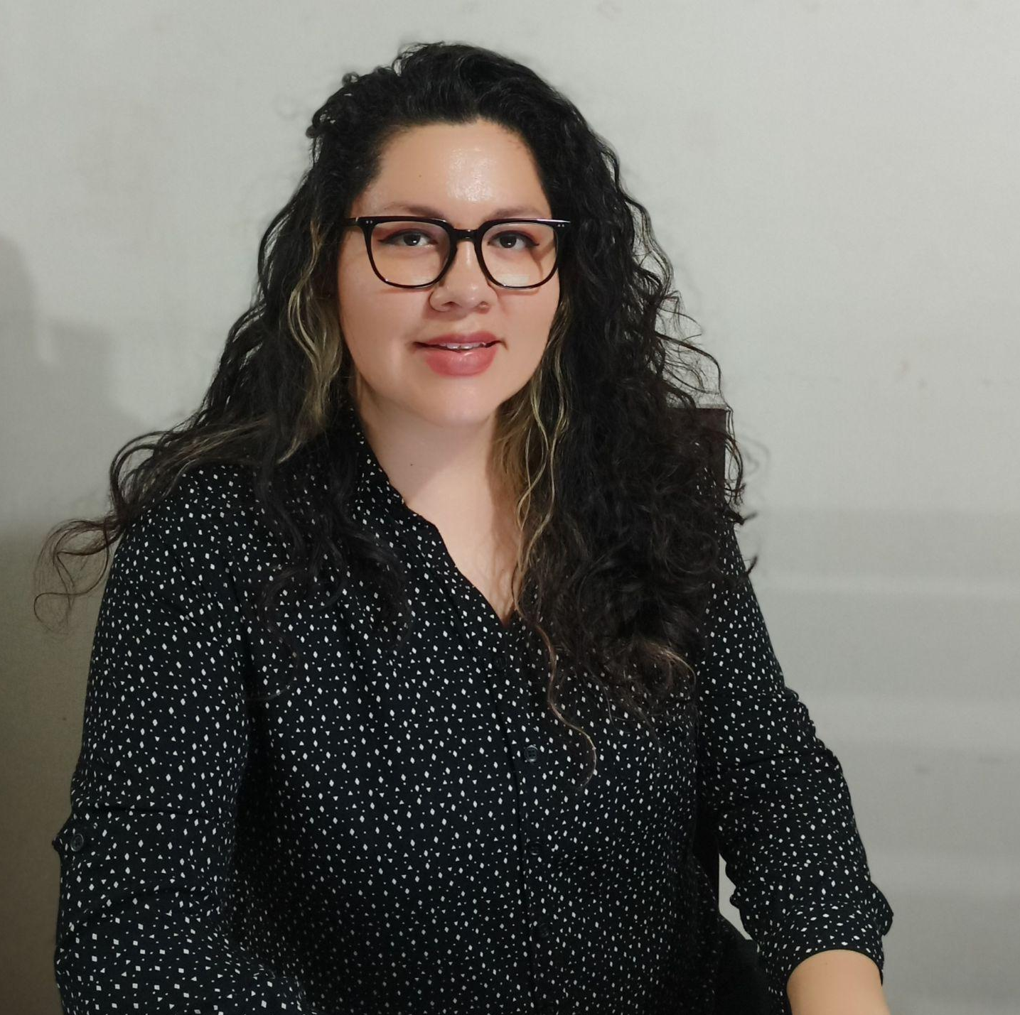
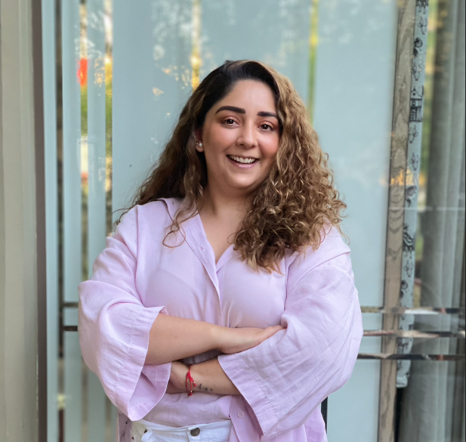
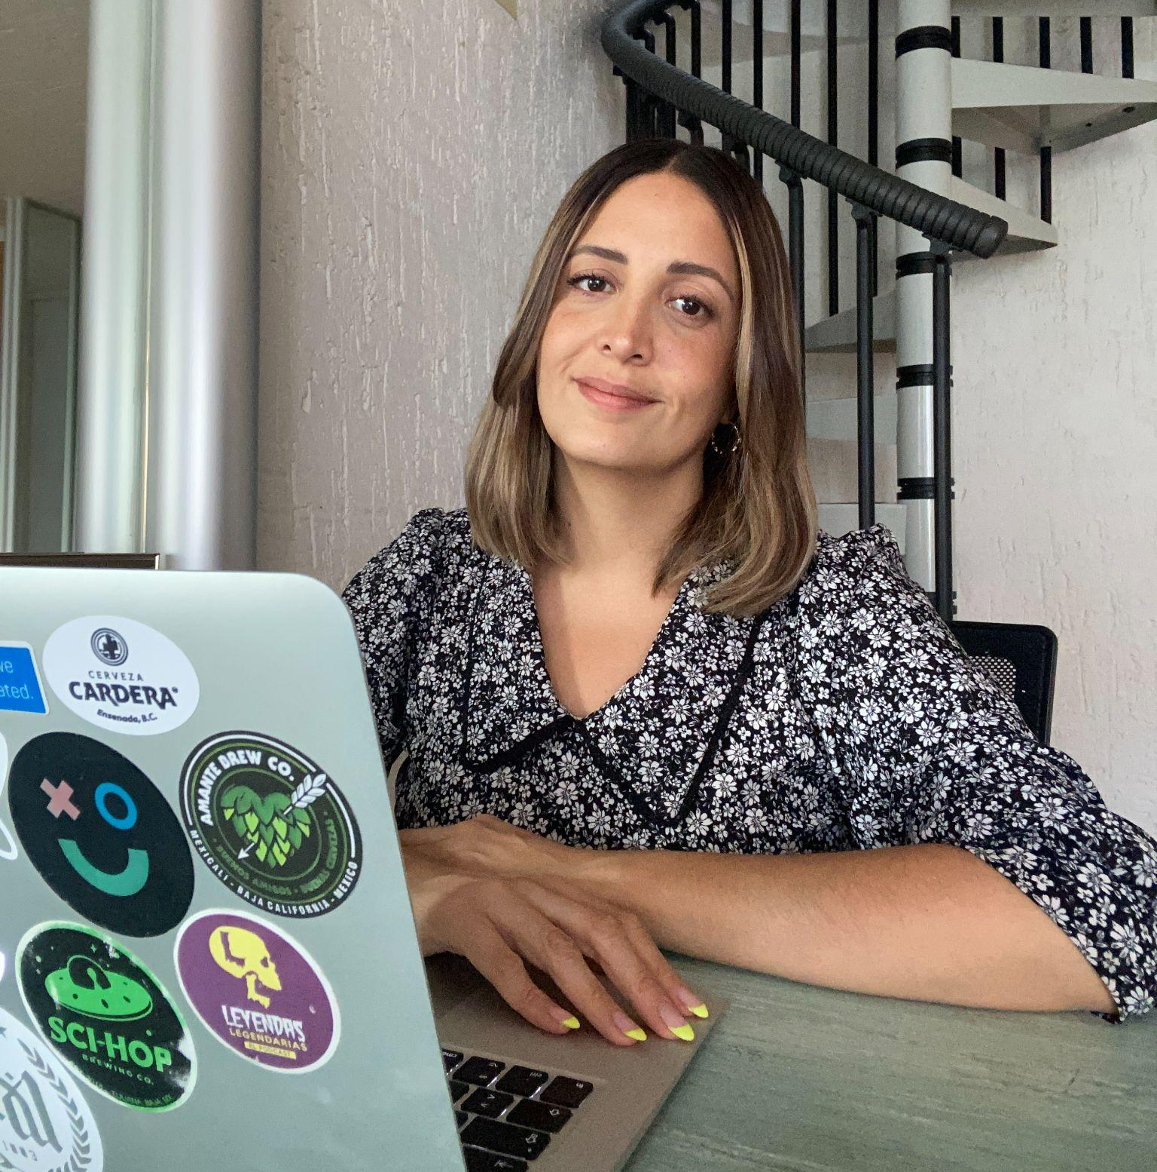
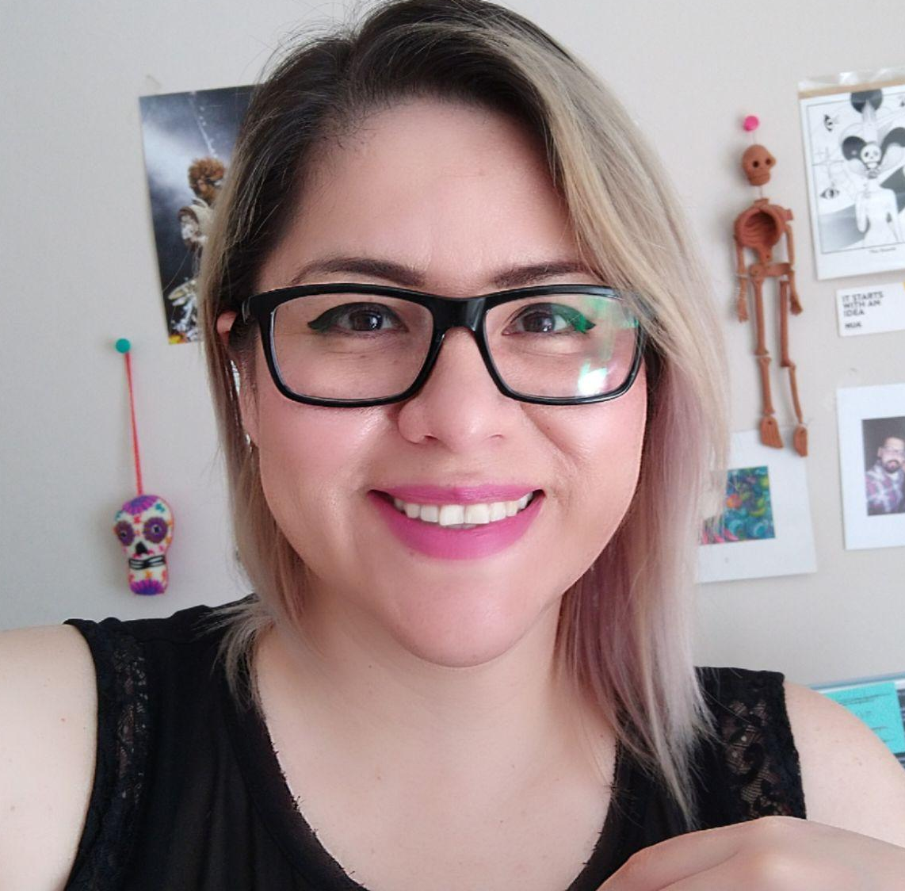

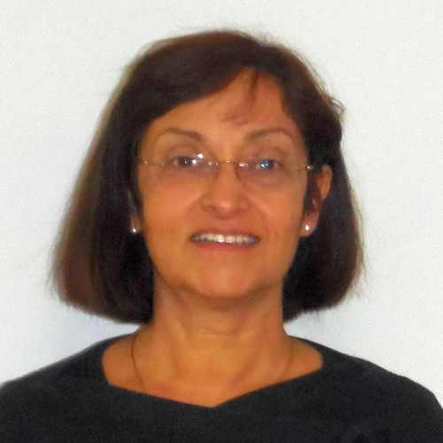
Tatiana Estévez
#TechQuieroTeam_
Daniela Contreras
We are 7 team members, with experience in tech companies, digital, and innovation fields such as:
Centraal, GDEs, Connectory by Bosch, Salesforce, Desjardins, EPAM Systems, Coppel (e-commerce) and more.
Priscila Casillas
Beatríz López
Rosa Contreras
Vladimir Estevez
Laura Carlucci

Slide 4
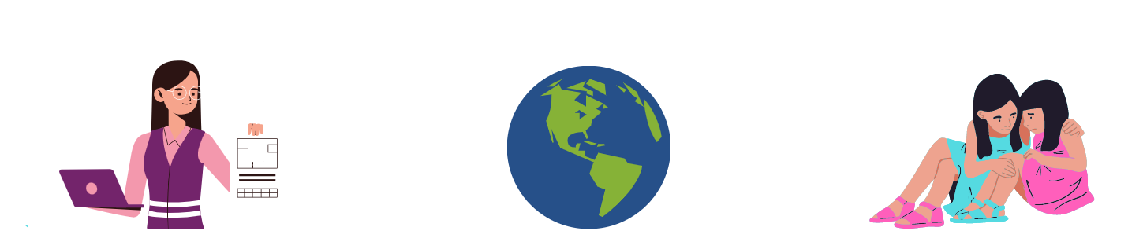
Why did we undertake this initiative?
Only 30% of women choose to study a career related to these fields.
On average in America, less than 20% of STEM (science, technology, engineering, and math) graduates are women.
The gender gap in performance in science, technology, engineering and mathematics is largely due to the low level of trust that girls receive from their parents and society***
SOURCES: *Data from UNESCO, May 2020. ** El Economista. *** Organización para la Cooperación y el Desarrollo Económicos (OCDE) 2015.

Slide 5
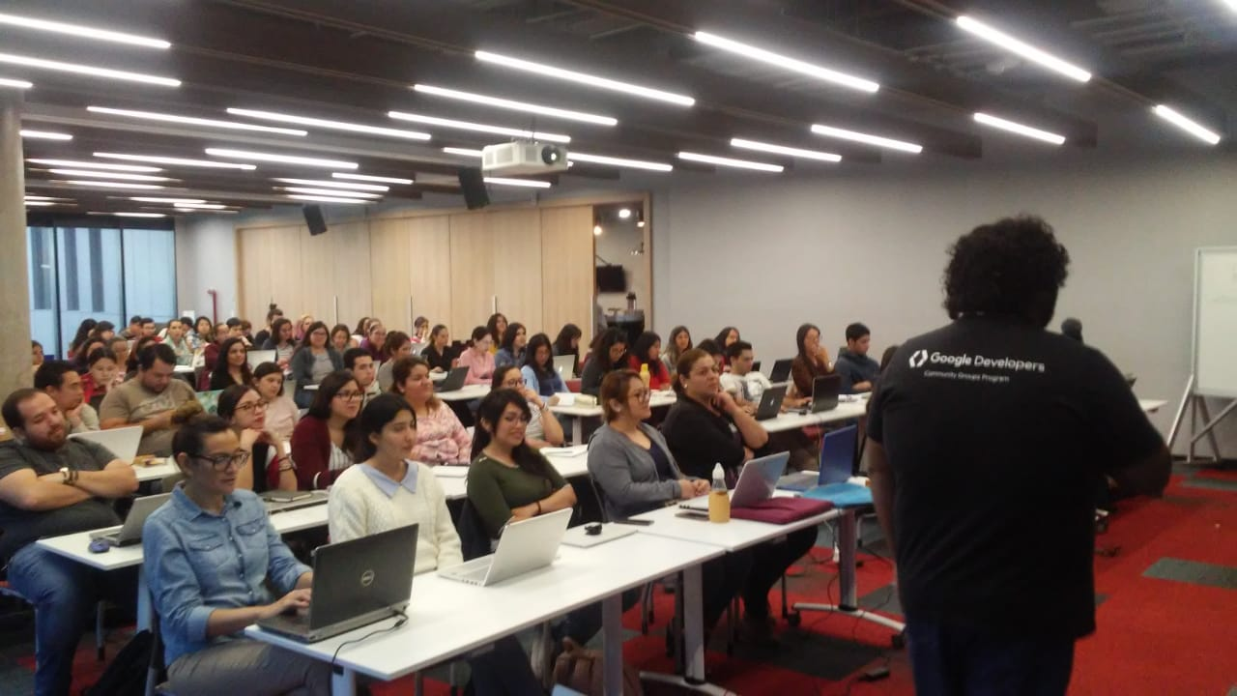
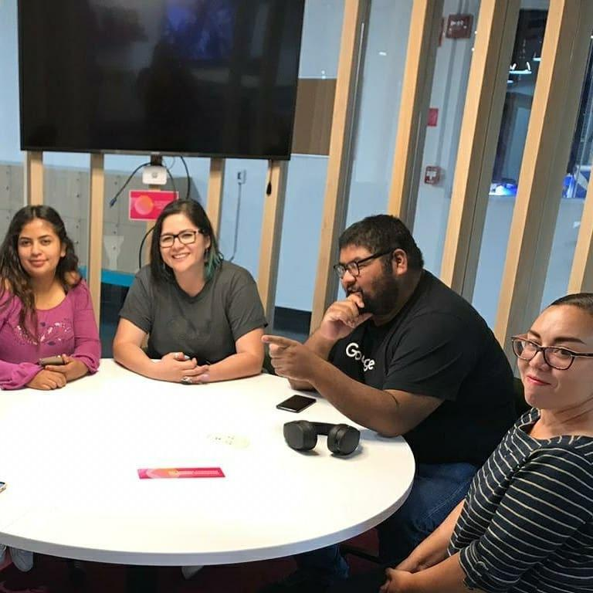
About us
Activities
Meetups
Workshops
Online classes
Conferences
Mentoring
Topics
Digital Marketing
Programming
Digital design
UX/UI
Entrepreneurship
Makers
Tech trends
Our activities are free for the community

Slide 6
Our achievements to date
+3,600
+70
+370 hs
OF CONTENT
that we have generated to share with our community
ASSISTANTS
who participated in our activities.
EVENTS
organized both online and in person.
.

Slide 7
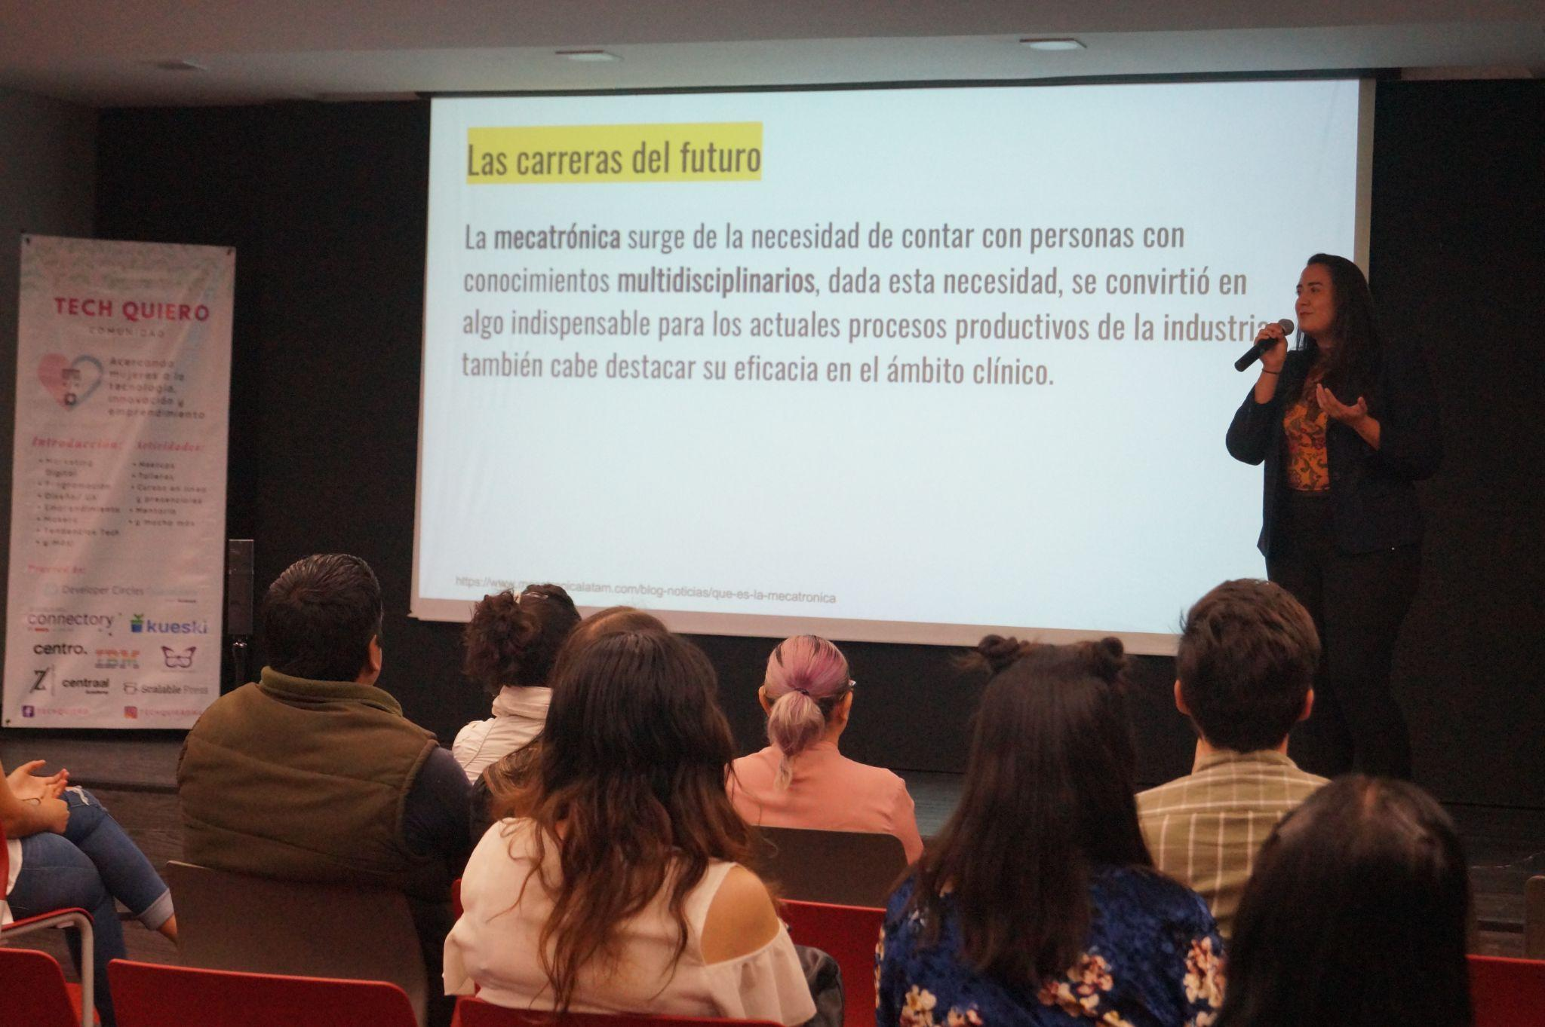
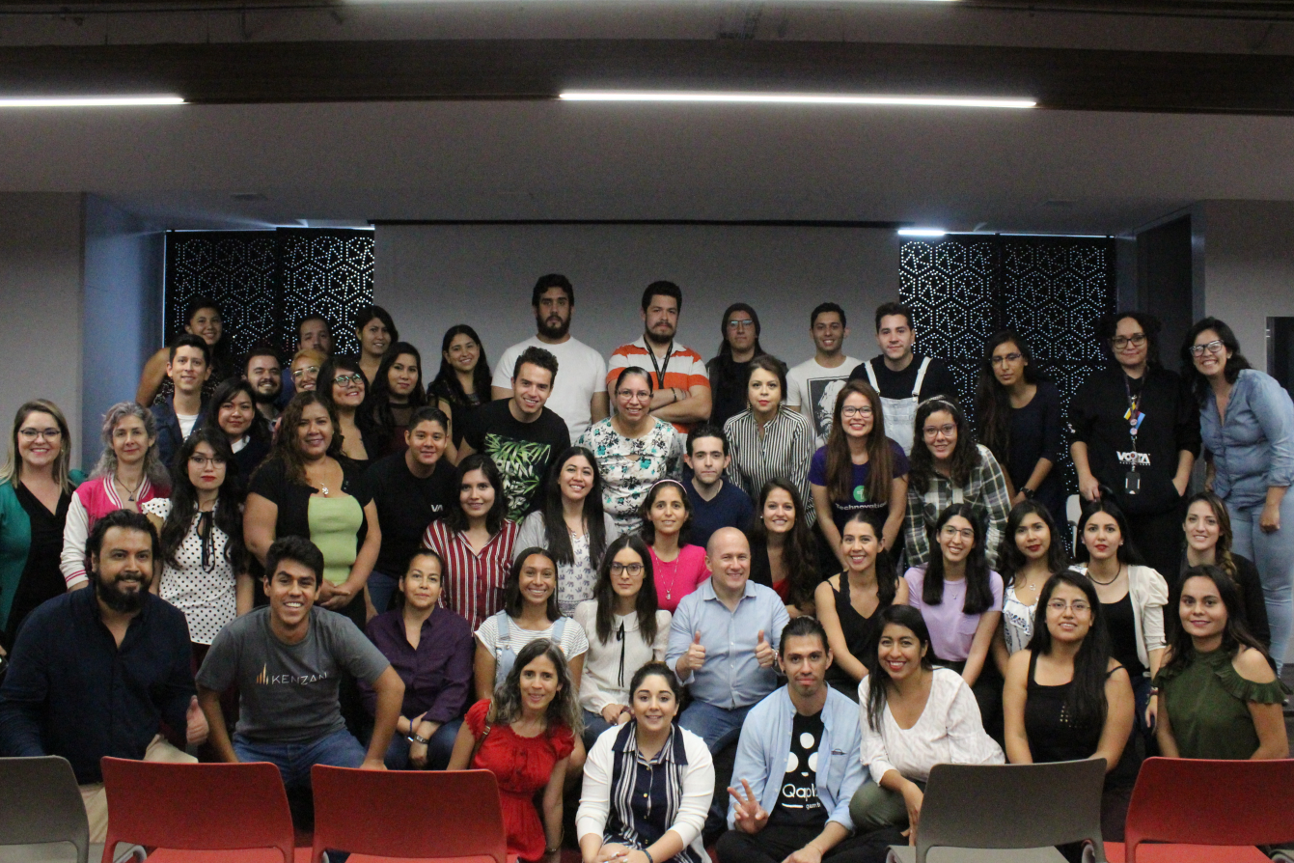
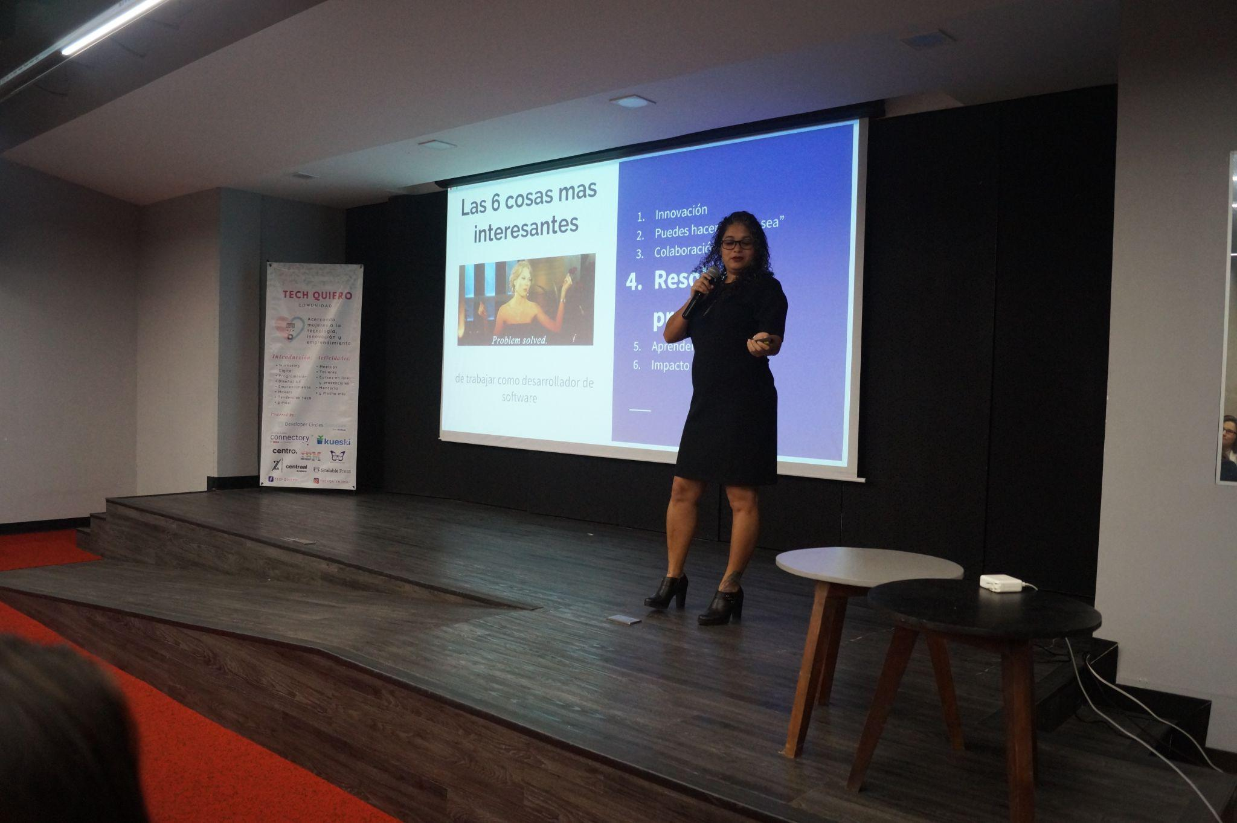
Our annual event:
Tech Career Fest
9 hrs
Of content
150 Assistants
Blockchain
Aeronautics
Programming
Data Science
Digital Marketing
Technological innovation
Clean technologies
Mechatronics
UX
Software Solutions
Topics
+10
Speakers

Slide 8
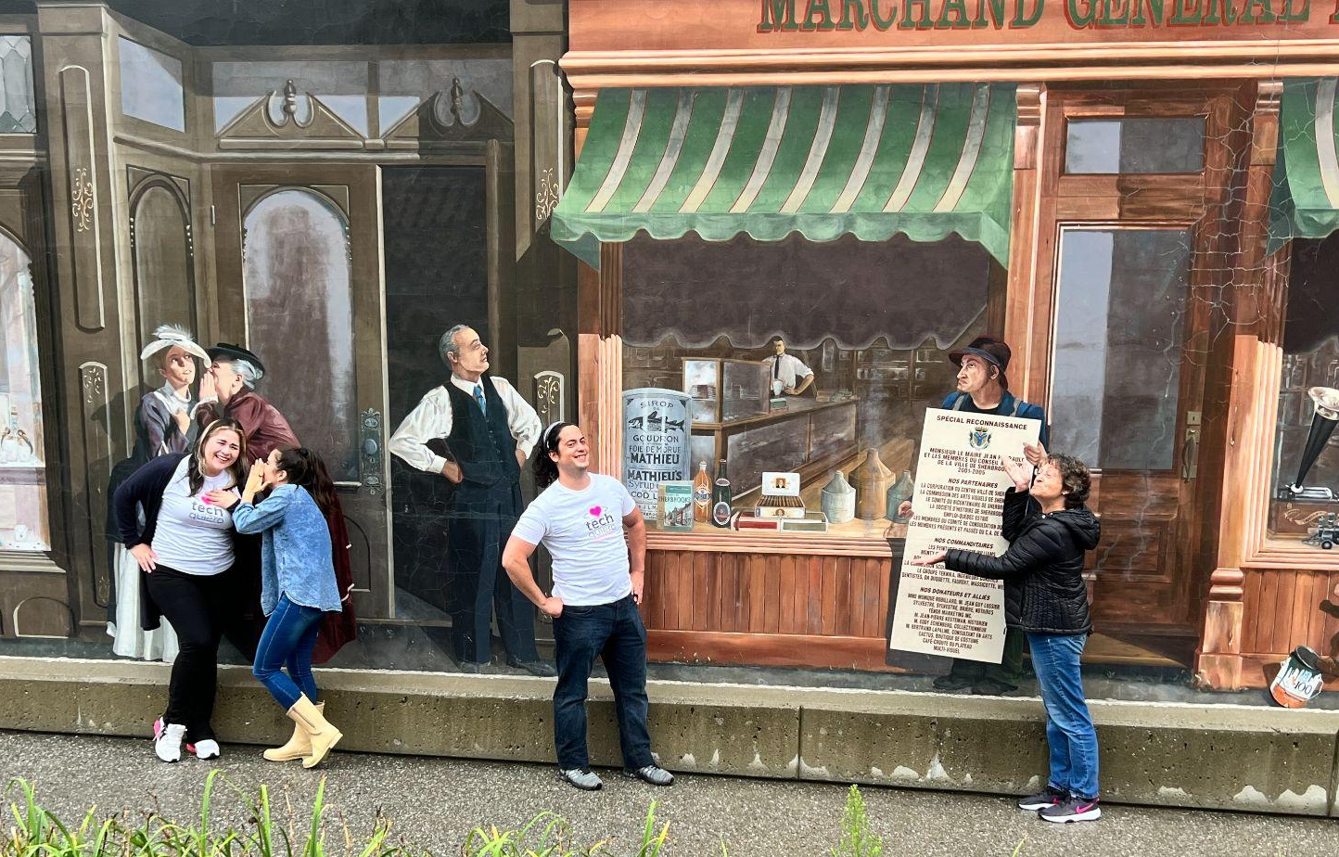
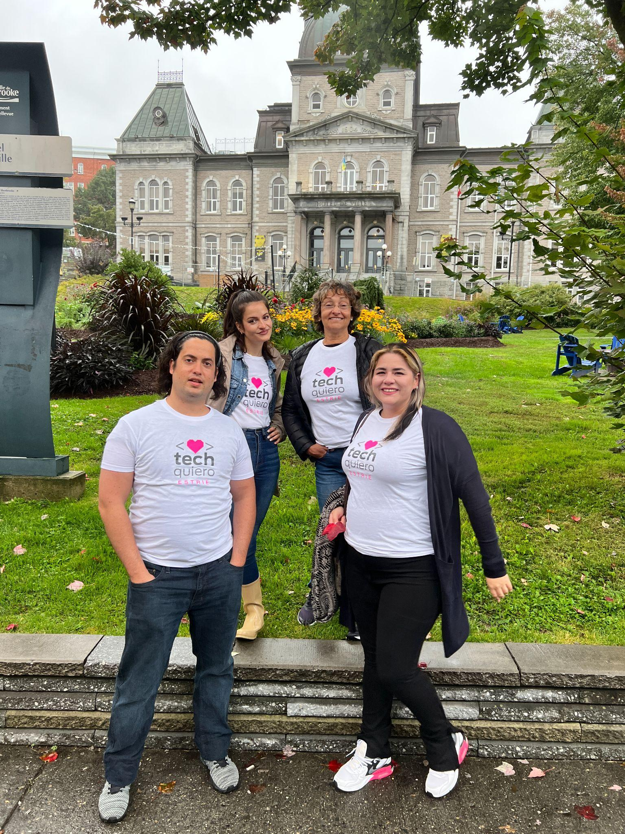
#TechQuieroCanada
We are 4 members, with experience in technology companies, in the digital field, project management and programming.

Slide 9

Join us as we continue to work to close the gender and minority gap in the world of technology.
Contact:
Tatiana Estevez
Website
www.techquiero.com
Email:
Tatiana@techquiero.com

Slide 10

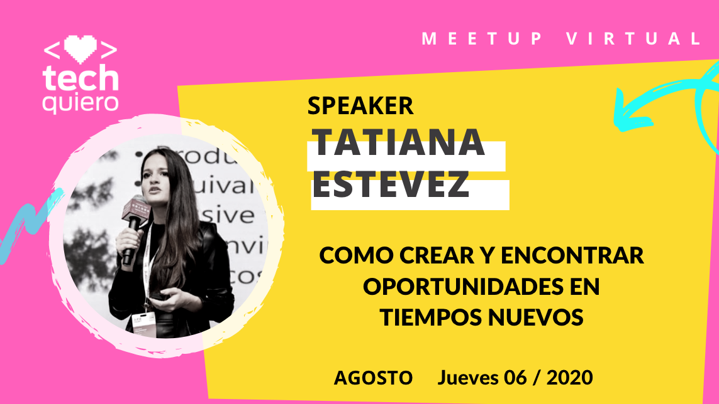


Tech Quiero Community

